Slide 1

GCC High Roadmap – AOSG Partners June 2022 Paul.Meacham@Microsoft.com Director, Aerospace & Defense Team Richard.Wakeman@Microsoft.com Chief Architect, Aerospace & Defense Team

Slide 2
Microsoft 365 GCCH Roadmap

Slide 3
CMMC Acceleration Program Update - March 2022
Reciprocity & Inheritance
Microsoft Product Placemat for CMMC
Azure Sentinel: CMMC Workbook
STIG Automation
Microsoft 365 Compliance Manager CMMC Levels 1-3 Assessment Templates
Azure Blueprint for CMMC Level 2
Azure Security Benchmark Foundation Blueprint
Cloud Adoption Framework Enterprise Scale Landing Zone
CMMC Technical Reference Guide
Updated
Updated
Updated
Updated
Updated
Updated
New!

Slide 4
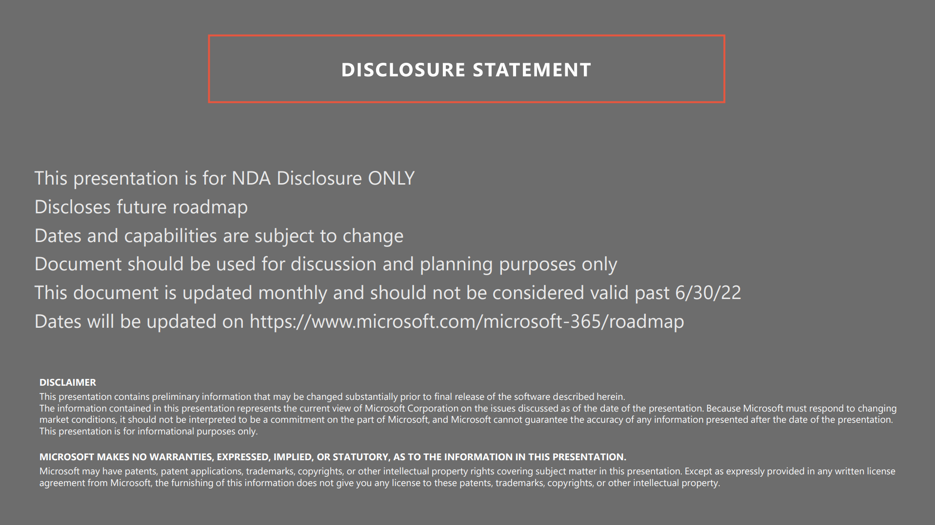

Slide 5
Big Announcements
Microsoft Entra
Azure AD
Verified ID
Permissions Management (Cloudknox)
Microsoft Purview (Compliance)
Microsoft Priva
Certificate Based Authentication (Preview)
Cross Tenant Access Settings (Preview)
Cross Cloud B2B (Preview)
Cross Cloud Anonymous Meeting Join (GA)

Slide 6
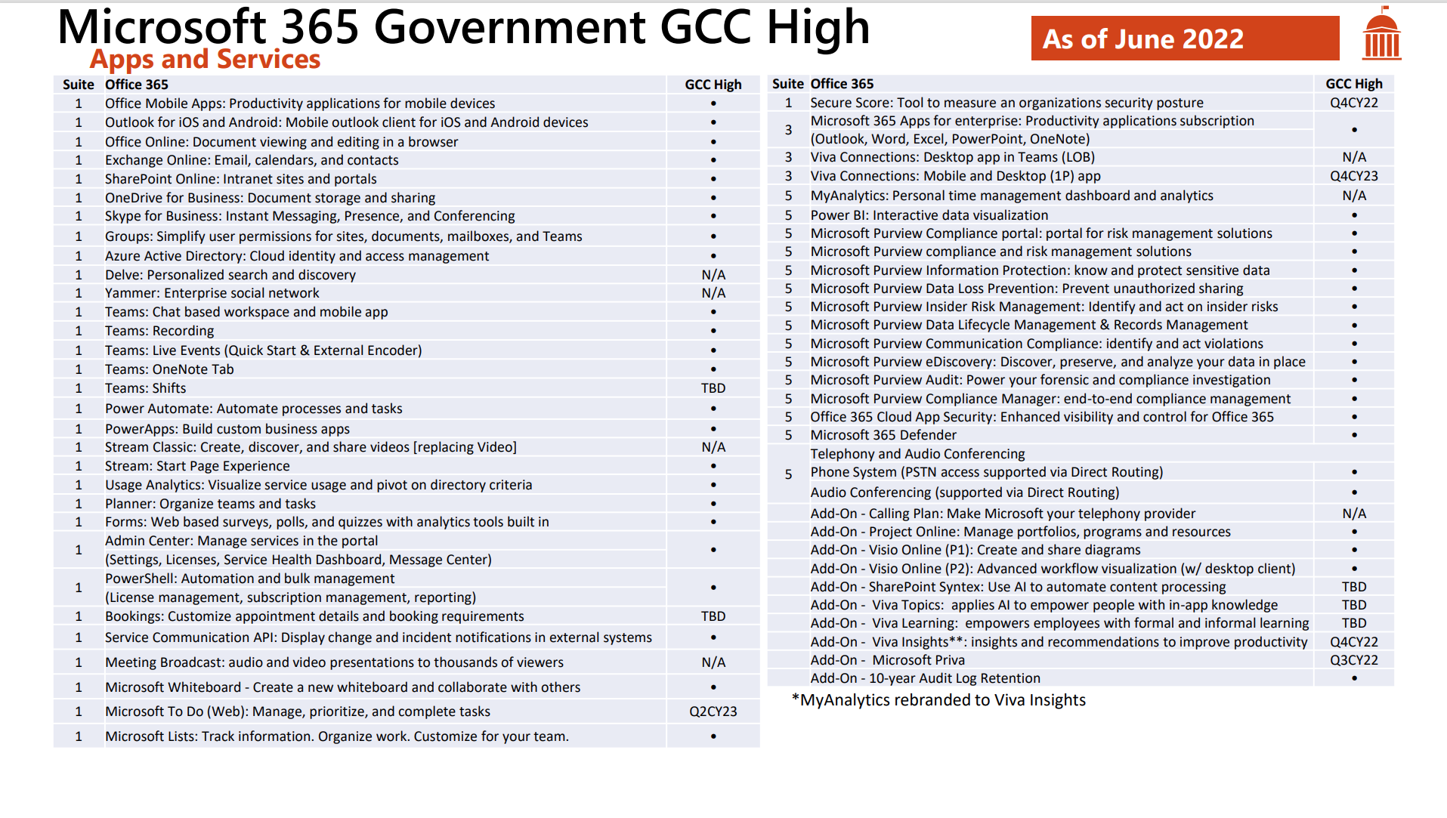

Slide 7
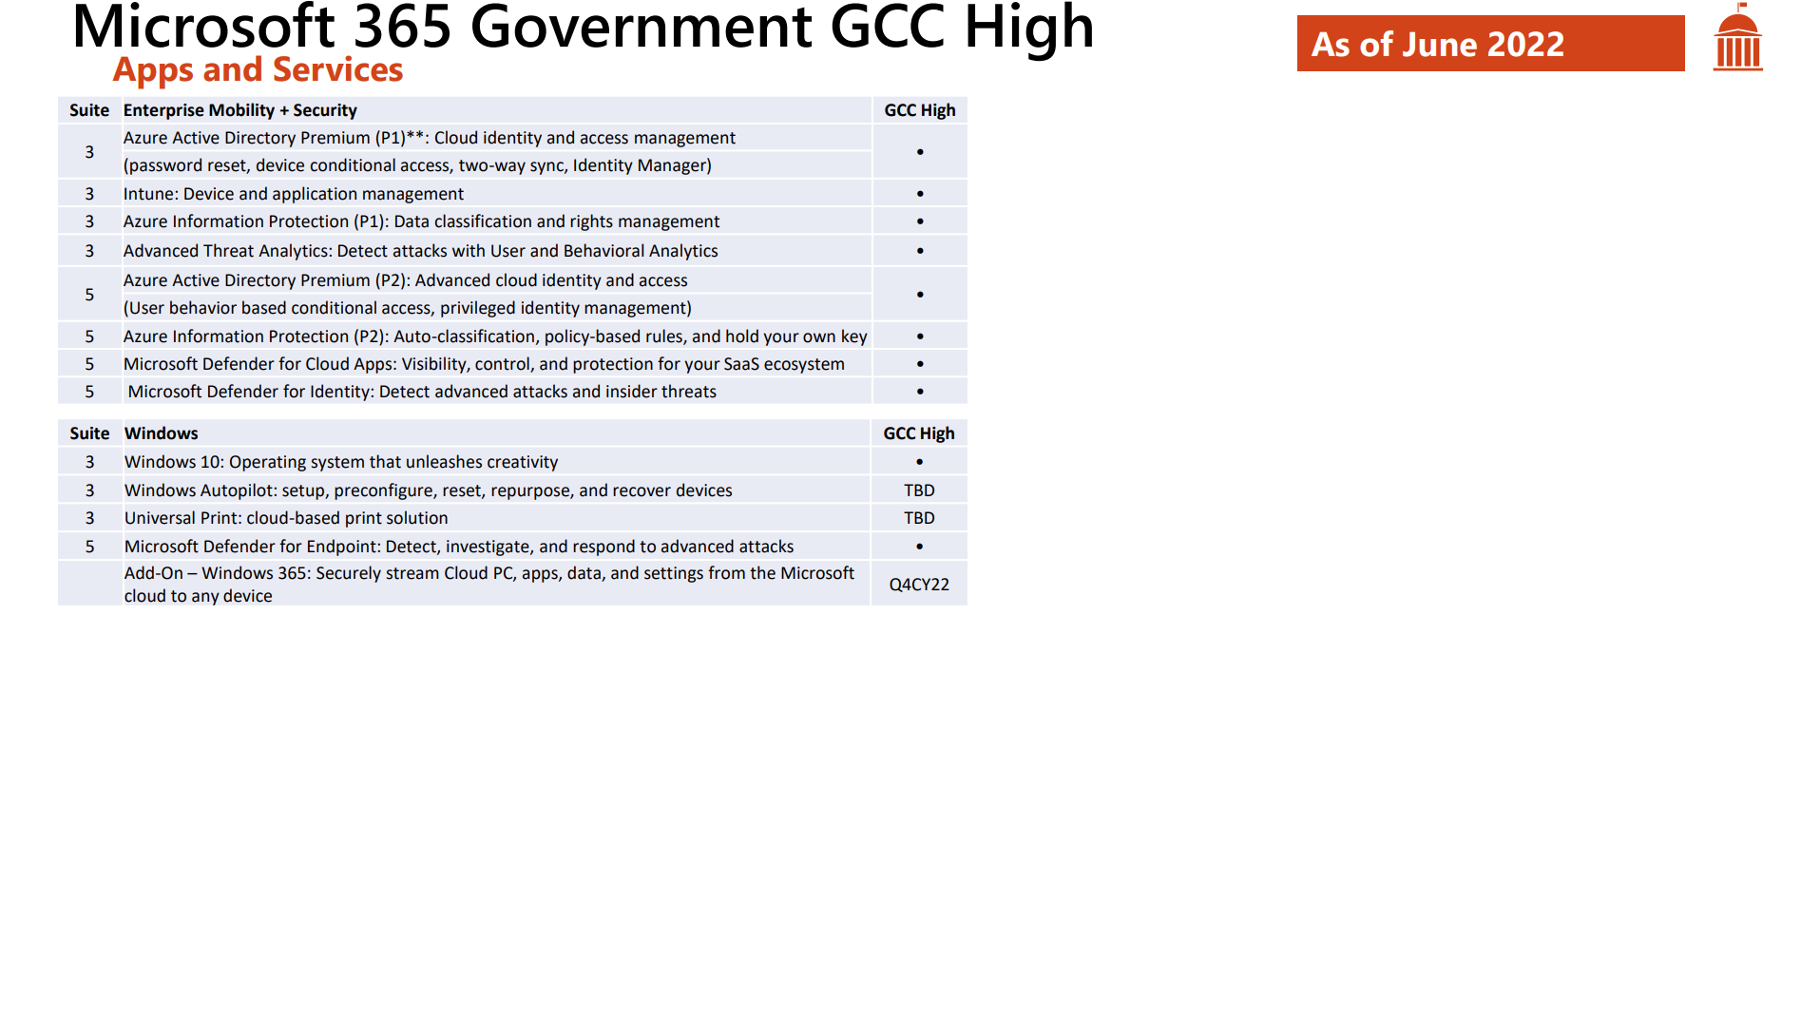

Slide 8
What is included in M365 G3 GCC High?
Office 365 E3
Exchange Online (DLP, EOP, OME)
SharePoint Online (DLP)
Stream
Teams
Audio Conferencing (DR)
Microsoft 365 Apps for Enterprise
Whiteboard
Power Apps
Power Automate
Lists
Forms
Planner
Tasks
To Do (Web)(Q2CT23)
Visio 365
eDiscovery, Litigation Hold
EMS E3
Azure Active Directory P1
Multi-factor authentication
Azure MFA
FIDO2
OATH HW (TBD)
CAC/PIV CBA (Preview)
Conditional Access
Device
IP Location
Application
User or Group
Single Sign-On
Self Service Password Reset
Config Manager / Intune
Mobile Device Management
Mobile App Management
Autopilot (TBD)
Co-management
Azure Information Protection Plan 1
Windows E3
Windows 11
Credential Guard
Device Guard
AppLocker Management
Application Virtualization
User Experience Virtualization
Managed User Experience
Universal Print (TBD)
Notes:
M365 G5 Security GCCH $12.03
MDE $5.75
MDI $5.23
MDO P1 $1.79
MDO P2 $$3.45
AAD P2 $3.03
M365 G5 Security GCCH $12.57
MDfCA $3.33
M365 G5 eDiscovery & Audit $5.83
M365 G5 IRM $5.83
M365 G5 $6.80
Teams Phone $7.32
Power BI Pro $10.04

Slide 9
What is included in M365 G5 GCC High?
M365 E5 Security bundle
Microsoft Defender for Office P1
Safe links & safe attachments
AntiPhishing
Microsoft Defender for Office P2
Threat Trackers & Threat Explorer
Automated Investigation response
Microsoft Defender for Identity
UEBA
Microsoft Defender for Endpoints
EPP / EDR
Microsoft 365 Defender
XDR
Azure Active Directory P2
Identity Protection
Risky Account Detection
Risk Events Investigations
Risk Based Conditional Access Policies
Conditional Access for B2B
Identity Governance
Privileged Identity Management
Access Reviews
Entitlement Management
M365 E5 Purview (Compliance) bundle
M365 G5 Purview Advanced Audit
Advance eDiscovery
Audit (Premium)
1 year Log Retention
Post event review (e.g., MailItemsAccessed)
Search Term events Exchange & SharePoint
Mail Forward & Mail send events
Legal Hold Teams Private Channel Messages
M365 G5 Purview Insider Risk Management
Customer Lockbox
Communication Compliance
Insider Risk Management
Information Barriers
Privileged Access Management (TBD)
Purview Compliance Manager
CMMC Template
DFARS Template
FedRAMP Template
ISO 27001 Template
SOC Template
GDPR Template
M365 G5 Purview Information Protection & Governance (IP&G)
Microsoft Defender for Cloud Apps
Endpoint Data Loss Prevention
Teams Data Loss Prevention
Service Encryption w/Customer Key
Double Key Encryption (DKE)
Advanced Message Encryption
Records Management
Automated Sensitivity Labels
On-premises Scanner
Trainable Classifiers
Teams Phone
Power BI Pro
Notes:
M365 G5 Security GCCH $12.03
MDE $5.75
MDI $5.23
MDO P1 $1.79
MDO P2 $$3.45
AAD P2 $3.03
M365 G5 Security GCCH $12.57
MDfCA $3.33
M365 G5 eDiscovery & Audit $5.83
M365 G5 IRM $5.83
M365 G5 $6.80
Teams Phone $7.32
Power BI Pro $10.04

Slide 10
Cross-cloud collaboration

Slide 11
Microsoft 365 – Secure & compliant collaboration & productivity
M365 WW
M365 GCC
M365 GCC High
M365 DOD
M365 Secret & Top Secret
Federal Agencies & Defense Industrial Base (DIB)
Worldwide Commercial Businesses & Governments
State & Local / Federal Agencies
Department of Defense (DoD)
Government customers and partners with US Secret classified workloads
High Impact CUI, PII, PHI
High Impact CUI, PII, PHI, FTI
High Impact CUI, PII, PHI, CDI,
Export Controls
High Impact CUI, PII, PHI, CDI, Export Controls
Classified Secret & TS/SCI level data
ISO, SOC, CIS, HIPAA,
NIST 800-171/53, IRAP, G-Cloud, GDPR
IRS 1075, CJIS, FedRAMP High/Mod, HIPAA, NIST 800-171/53
ITAR, DFARS,
NIST 800-171/53
CMMC
DoD SRG IL4 & IL5,
NIST 800-171/53
ICD 503/705/731,
DoD SRG IL6

Slide 12
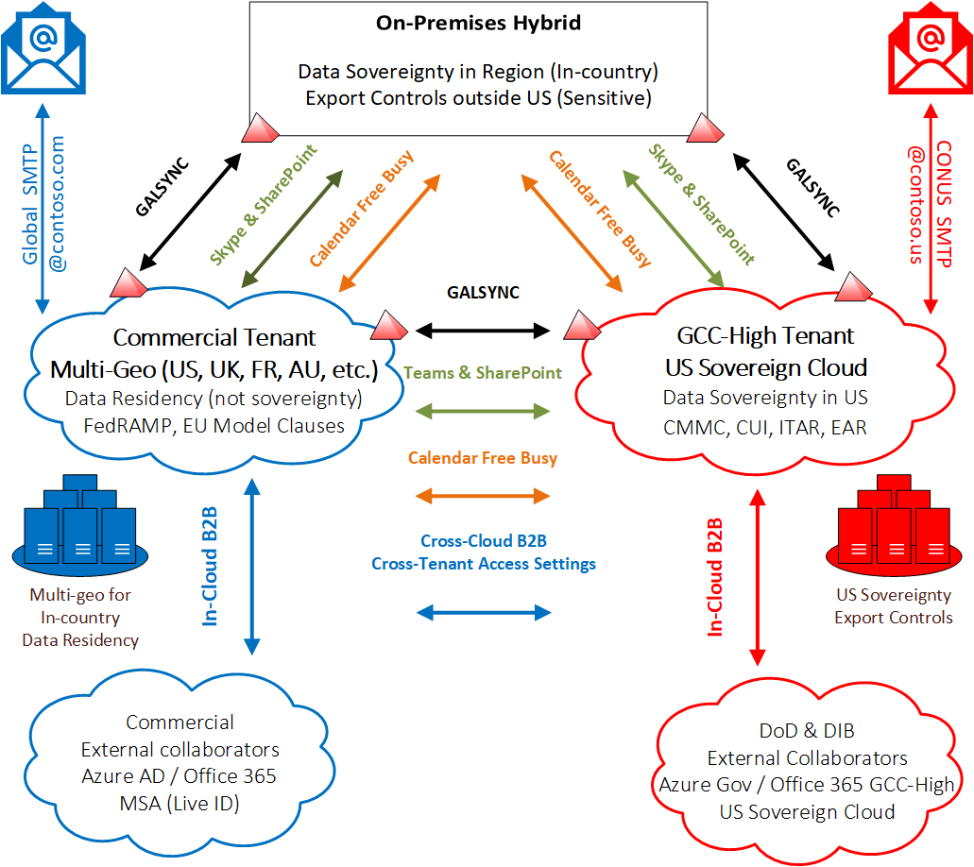

Collaborative Experience in a multi-tenant model
H1 CY 2022 (Current State)
In-Cloud B2B and Cross-Tenant Access Settings for bi-directional sharing scenarios across GCC High & DoD
Exchange Free/Busy Calendar Sharing is bi-directional
Teams meeting cross-cloud anonymous join (client)
Document Sharing via SharePoint Online & OneDrive for Business with Email + Passcode Verification
Microsoft Information Protection encryption works In-cloud and restricted to GCC High & DoD tenants
Office Message Encryption (OME) works cross-cloud
Cross-Cloud B2B Public Preview for bi-directional sharing scenarios across Commercial, GCC High & DoD
Cross-Tenant Access Settings
Document Sharing with SharePoint Online, OneDrive for Business & Teams with external sharing features to Guest accounts
Web application sharing Cross-Sovereign Cloud scenarios
Microsoft Information Protection Encryption
Teams authenticated meeting join
Teams Channel Guest Access
Cross-cloud B2B

Slide 13
Collaborative Experience in a multi-tenant model
H2 CY 2022 (Future State)
In-Cloud B2B and Cross-Tenant Access Settings for bi-directional sharing scenarios across GCC High & DoD
Exchange Free/Busy Calendar Sharing is bi-directional
Teams meeting cross-cloud anonymous join (client)
Document Sharing via SharePoint Online & OneDrive for Business with Email + Passcode Verification
Microsoft Information Protection & Office Message Encryption (OME) encryption works Cross-Cloud
Cross-Cloud B2B Generally Available for bi-directional sharing scenarios across Commercial, GCC High & DoD
Cross-Tenant Access Settings
Document Sharing with SharePoint Online, OneDrive for Business & Teams with external sharing features to Guest accounts
Web application sharing Cross-Sovereign Cloud scenarios
Microsoft Information Protection Encryption
Teams authenticated meeting join (Preview)
Teams Channel Guest Access (Preview)
Cross-cloud B2B

Slide 14
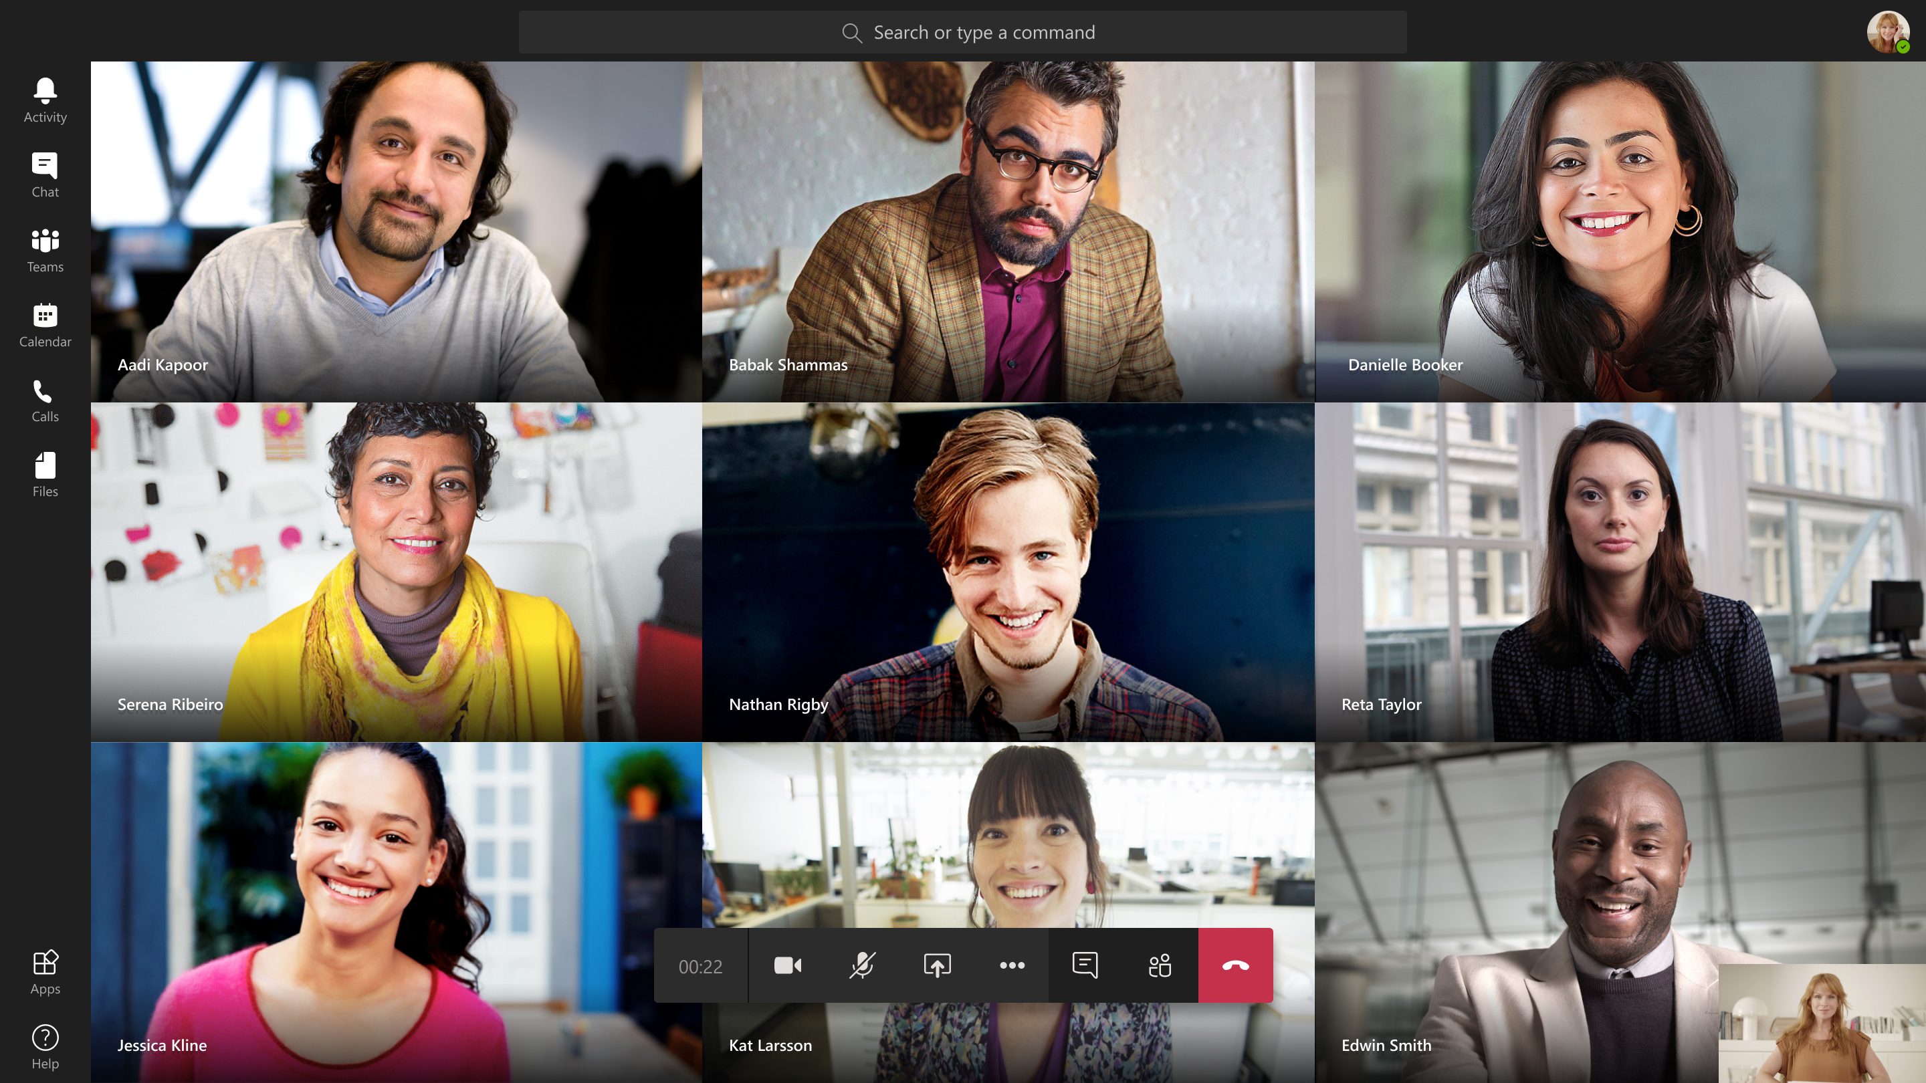
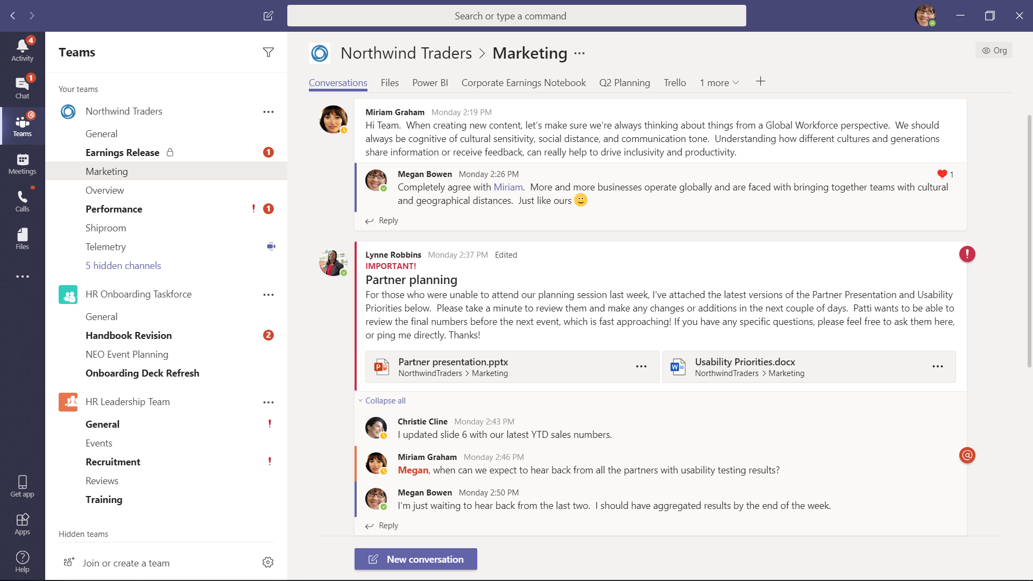
Collaboration Modalities
Classic Collaboration
Same Cloud and Cross-Cloud Today
Teams Meetings (audio and video) – Anyone (web & client)
Teams 1:1 Chat, VoIP & Video calls – Federation
Teams Presence - Federation
File sharing & coauthoring with any user from any cloud using only their email – SharePoint & OneDrive One Time Passcode
See calendar availability – Calendar Free/Busy
Rich Collaboration
Same Cloud Today, Cross-Cloud H2CY22
Classic Collab capabilities, plus:
AAD authenticated application access - Guest User Access
SharePoint & OneDrive – Guest User Access
Teams Channels - Guest User Access
Teams meetings identity attestation - Guest User Access
Teams meeting recording access - Guest User Access

Slide 15
Teams Federation vs. Guest User Access
External Access (Team’s Federation)
Teams only functionality
This is a way for Teams users from an entire external domain to find, call, chat, and set up meetings with you in Teams.
To enable users in your organization to communicate with users in another organization, both organizations must enable federation.
Limitations
No sharing of files
Additional users can’t be added to existing chat with external user
Individual user can’t be blocked
No OOO notification
No Meet Now function
Guest User Access (B2B)
Allows sharing of applications and services from another organization.
Invitation & Redemption process with One-time passcode.
User Shows up as a guest (in your AAD)

Slide 16


Current State - M365 GCCH Teams Rich Collaboration in-cloud, Classic Collaboration cross-cloud
Fabrikam.us
GCCH
us.army.mil
DOD
Authenticated Join
Unauthenticated Join
mail.mil
IL5
Contoso.com
GCC
Unauthenticated Join
GCCH hosted meeting
Authenticated Join
Unauthenticated Join
MSFTFed.com
GCCH
Microsoft.com
Commercial

Slide 17
Future State - M365 GCCH Teams Rich Collaboration in-cloud and cross-cloud
Fabrikam.us
GCCH
us.army.mil
DOD
Authenticated Join
Authenticated Join
mail.mil
IL5
Contoso.com
GCC
Authenticated Join
GCCH hosted meeting
Authenticated Join
Authenticated Join
MSFTFed.com
GCCH
Microsoft.com
Commercial

Slide 18
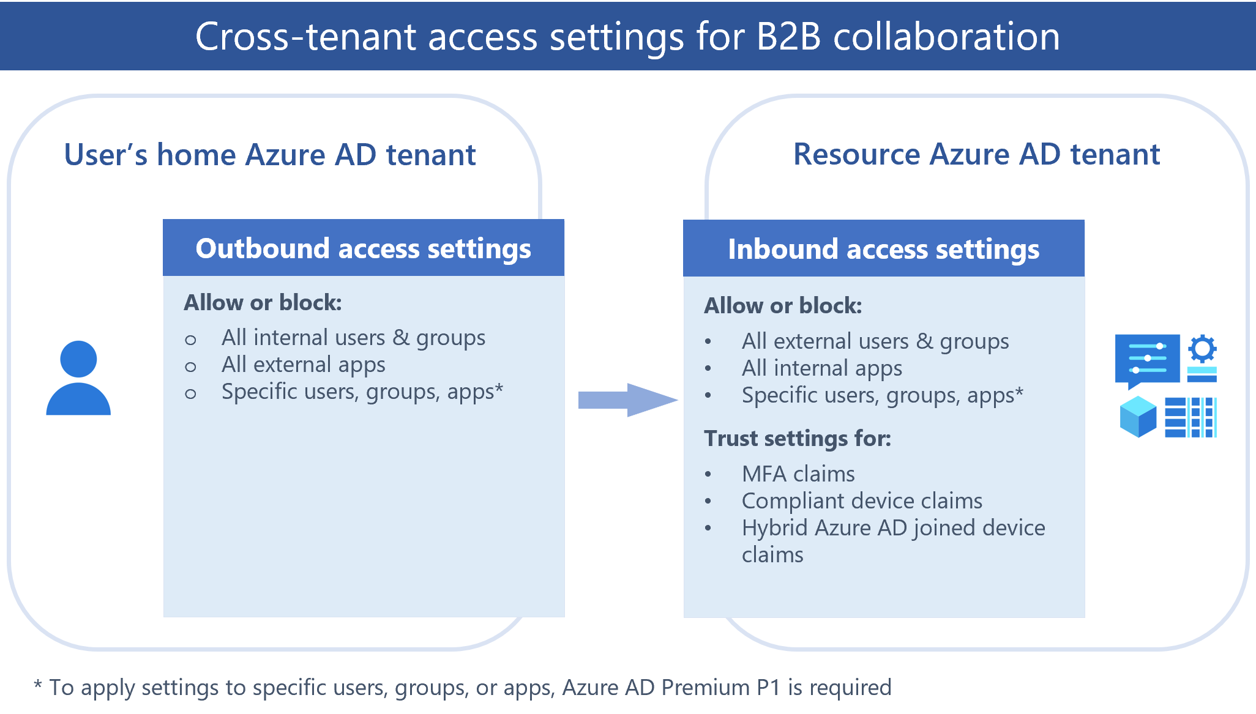
Notes:
Cross-tenant access overview - Azure AD - Microsoft Entra | Microsoft Docs

Slide 19
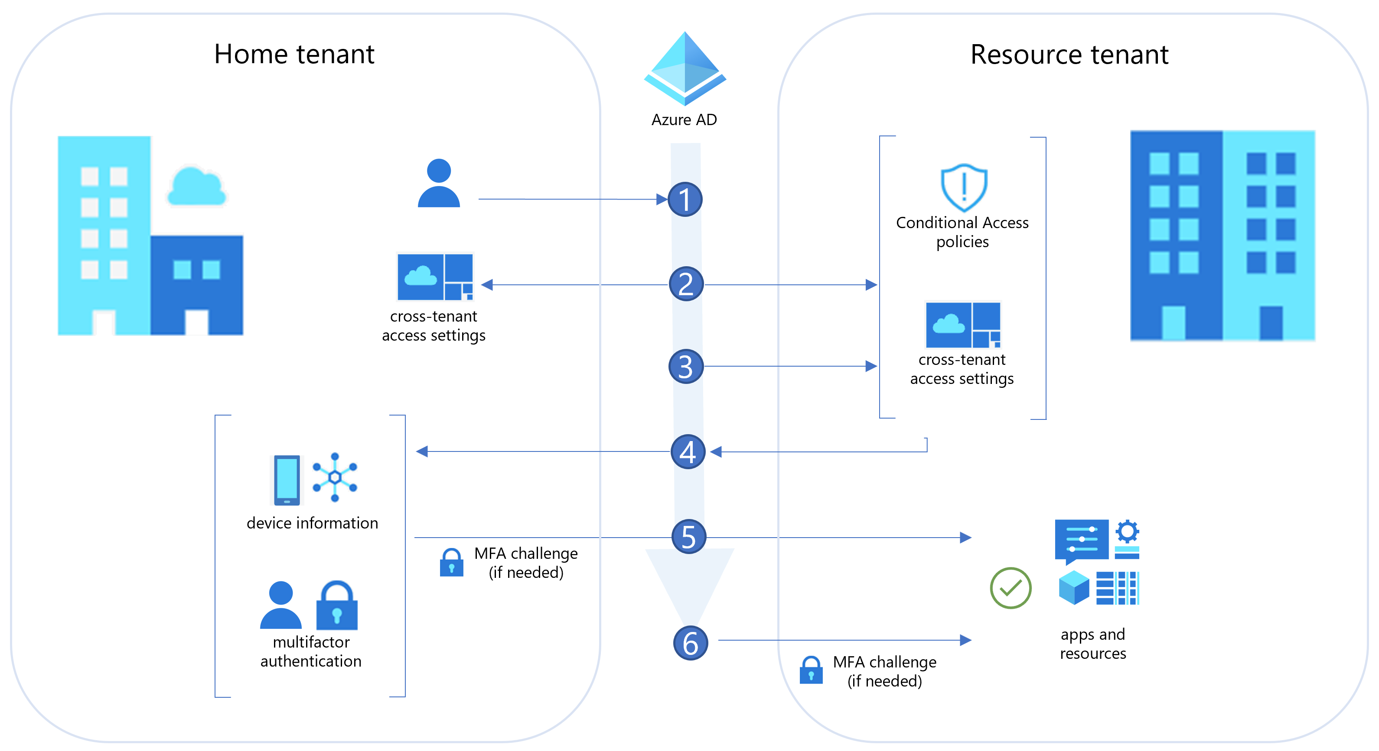
A user from Fabrikam (the user’s home tenant) initiates sign-in to a resource in Contoso (the resource tenant).
During sign-in, the Azure AD security token service (STS) evaluates Contoso's Conditional Access policies. It also checks whether the Fabrikam user is allowed access by evaluating cross-tenant access settings (Fabrikam’s outbound settings and Contoso’s inbound settings).
Azure AD checks Contoso’s inbound trust settings to see if Contoso trusts MFA and device claims (device compliance, hybrid Azure AD joined status) from Fabrikam. If not, skip to step 6.
If Contoso trusts MFA and device claims from Fabrikam, Azure AD checks the user’s credentials for an indication the user has completed MFA. If Contoso trusts device information from Fabrikam, Azure AD uses the device ID to look up the device object in Fabrikam to determine its state (compliant or hybrid Azure AD joined).
If MFA is required but not completed or if a device ID isn't provided, Azure AD issues MFA and device challenges in the user's home tenant as needed. When MFA and device requirements are satisfied in Fabrikam, the user is allowed access to the resource in Contoso. If the checks can’t be satisfied, access is blocked.
When no trust settings are configured and MFA is required, B2B collaboration users are prompted for MFA, which they need to satisfy in the resource tenant. If device compliance is required, access is blocked.

Slide 20
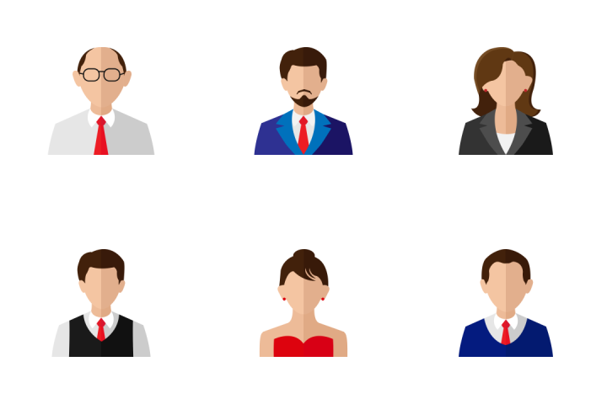
GCC High & Commercial customer / partner
Contoso Main CONUS
GCC High tenant
B2B inbound and outbound policies configured to share only with Fabrikam.
Files, Groups, Teams, Sites Labeled with AIP.
DLP policies to restrict “sensitive” data (to be defined).
“External Access” configured for Teams
Entitlement Management “Access Packages”
Cross-Cloud B2B, Cross-Tenant Access Settings
External Package
Group
SharePoint site(s)
Application(s)
Fabricam
Commercial tenant
Contoso partner or customer that needs access to some LOB apps & SharePoint sites to build a product.

Slide 21
Entitlement Management – Access Packages
Entitlement management introduces to Azure AD the concept of an access package. An access package is a bundle of all the resources with the access a user needs to work on a project or perform their task. Access packages are used to govern access for your internal employees, and also users outside your organization.
Here are the types of resources you can manage user's access to with entitlement management:
Membership of Azure AD security groups
Membership of Microsoft 365 Groups and Teams
Assignment to Azure AD enterprise applications, including SaaS applications and custom-integrated applications that support federation/single sign-on and/or provisioning
Membership of SharePoint Online sites
Notes:
Users may not know what access they should have, and even if they do, they may have difficulty locating the right individuals to approve their access
Once users find and receive access to a resource, they may hold on to access longer than is required for business purposes
These problems are compounded for users who need access from another organization, such as external users that are from supply chain organizations or other business partners. For example:
No one person may know all of the specific individuals in other organization's directories to be able to invite them
Even if they were able to invite these users, no one in that organization may remember to manage all of the users' access consistently

